Slide 1
Spatial analyses: Correlograms and dbMEM
Elizabeth Bowman
Arnold lab workshop
Spring 2017

Slide 2
What are these tests and why do we use them?
Ecologists are interested in understanding how communities are structured spatially and temporally
There are different influences at different scales
abiotic (climate, physical, chemical)
biotic (dispersal limitations, top-down processes)
historical events (disturbance)
Generally these factors are spatially structured
Family of analyses used are called Surface Trend Analysis
Notes:
condition of second order stationarity: uniform mean, covariance, and variance

Slide 3
What are you testing
Do samples that are similar in terms of the predictor (environmental) variables also tend to be similar in terms of the dependent (species) variable?
Null: there is no correlation between the predictor variable and the dependent variable.

Slide 4
Surface trend analysis
Spatial correlogram (Numerical Ecology, Ch13)
Mantel correlogram (Numerical Ecology, Ch13)
Distance Based Moran’s Eigenvector Maps (Numerical Ecology, Ch14)
Notes:
condition of second order stationarity: uniform mean, covariance, and variance

Slide 5
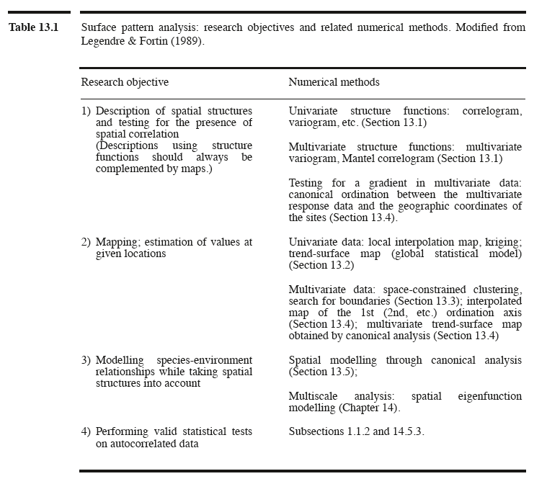
Surface trend analysis
Numerical Ecology
Notes:
condition of second order stationarity: uniform mean, covariance, and variance

Slide 6
Data used in analyses
Three data sets
‘mite’ contains a site x species matrix with data on 35 spp. of Oribatid mites
‘mite.xy’ contains geographic coordinates of each site
2.5 m x 10 m
‘mite.env’ contains environmental data for each site
Water content of the substrate (g/L) (quantitative)
Substrate density (g/L) (quantitative)
Substrate with 7 levels (categorical)
Shrub density (ordered categorical variable)
Microtopography (categorical)
Notes:
condition of second order stationarity: uniform mean, covariance, and variance

Slide 7
Spatial correlograms
Allows modelling of spatial structures
Plots some index of autocorrelation against distance classes
Moran’s I
Geary’s c
Univariate data
Quantitative variables
Useful explanatory and descriptive tool

Slide 8
Distance and dissimilarity matrices
Computes differences between pairs of observations
Many different formulas for computing distances
Euclidean is most commonly used with geographical distances and environmental variables
x
1
3
2
10
 | 1 | 3 | 2 | 10
1 | 0 | 2 | 1 | 9
3 | 2 | 0 | 1 | 7
2 | 1 | 1 | 0 | 8
10 | 9 | 7 | 8 | 0

Slide 9
Determination of distance classes
Number of distance classes is arbitrary
Narrower classes increases the resolution of the correlogram
More pairs in a distance class increases the power of the test
Different ways to have distance classes
Distance classes can be equal widths
Distance classes can contain the same number of pairs of observations
Notes:
Numerator is covariance or a measure of the strength of correlation of two variables (yh and yi). W(hi) is a weight for each distance class. If it falls within that distance class, then the weight will be 1 (or some other value) if that point is outside that distance class then w is 0, so that value is removed
Geary’s c 0 to some number larger than 1. if c is < 1, positive spatial correlation, if >1 negative. low values of c mean strong correlation.

Slide 10
Distance classes
4
5
2
1
2
3

Slide 11
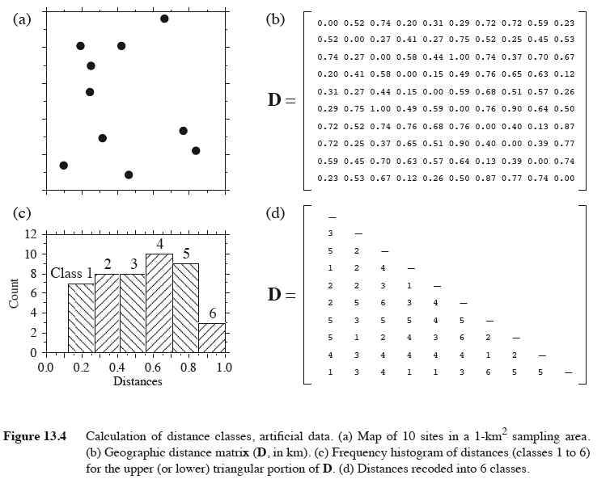
Distance classes

Slide 12
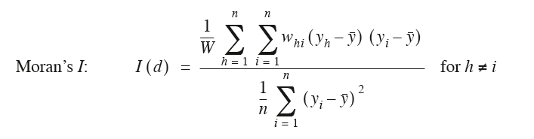
Moran’s I
Similar to Pearson’s correlation coefficient although some differences
Ranges from -1 to +1
A positive I translates to a positive spatial correlation in the data
A negative I translates to a negative spatial correlation in the data
Notes:
Numerator is covariance or a measure of the strength of correlation of two variables (yh and yi). W(hi) is a weight for each distance class. If it falls within that distance class, then the weight will be 1 (or some other value) if that point is outside that distance class then w is 0, so that value is removed
Geary’s c 0 to some number larger than 1. if c is < 1, positive spatial correlation, if >1 negative. low values of c mean strong correlation.

Slide 13
Spatial correlogram
Testing whether closer sites have more similar water density levels within the substrate
Null: Closer sites won’t have more similar water density levels.

Slide 14
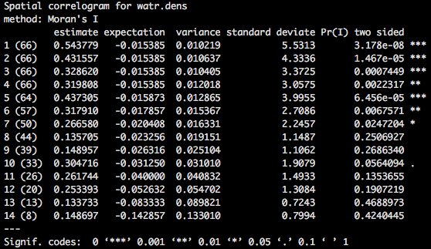
Spatial correlogram

Slide 15
Questions?
Notes:
condition of second order stationarity: uniform mean, covariance, and variance

Slide 16
Mantel correlograms
Originally developed to evaluate for the study of diseases
Evaluates correlation between distance or dissimilarity matrices
Null: there is no correlation between the predictor variable and the dependent variable.
x
1
3
2
10
 | 1 | 3 | 2 | 10
1 | 0 | 2 | 1 | 9
3 | 2 | 0 | 1 | 7
2 | 1 | 1 | 0 | 8
10 | 9 | 7 | 8 | 0

Slide 17
Mantel correlogram: basics
Use univariate or multivariate data
Quantitative or categorical data
Matrices must be of the same dimensions
Matrices must refer to the same objects in the same order
You are comparing different aspects of the same sampling units

Slide 18
Mantel correlogram
Testing whether closer sites have more similar mite communities
Null: Closer sites don’t have more similar communities

Slide 19
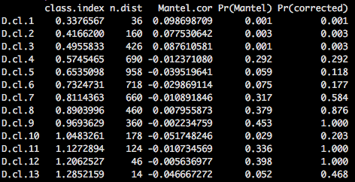
Mantel correlogram

Slide 20
Questions?
Notes:
condition of second order stationarity: uniform mean, covariance, and variance

Slide 21
Distance based Moran’s Eigenvector Maps
Originally called principal coordinates of neighbor matrices (PCNM)
Allows modelling of more complex spatial structures

Slide 22
dbMEM: basics
Construct a matric of Euclidean distances among sites
Truncate matrix to retain only the distances among close neighbors
Compute a PCoA of the truncated distance matrix
generally only the positive eigenfunctions are retained
this is done if you are only interested in positive spatial correlation
Use the eigenvectors as spatial explanatory variables

Slide 23
dbMEM
Evaluating how mite communities are correlated to environmental variables
Able to see spatial patterns in mite communities and environmental variables

Slide 24
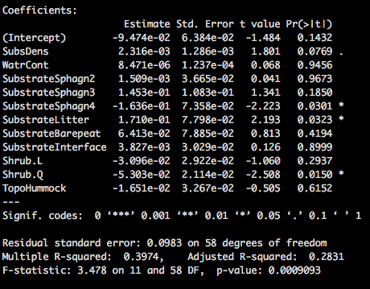
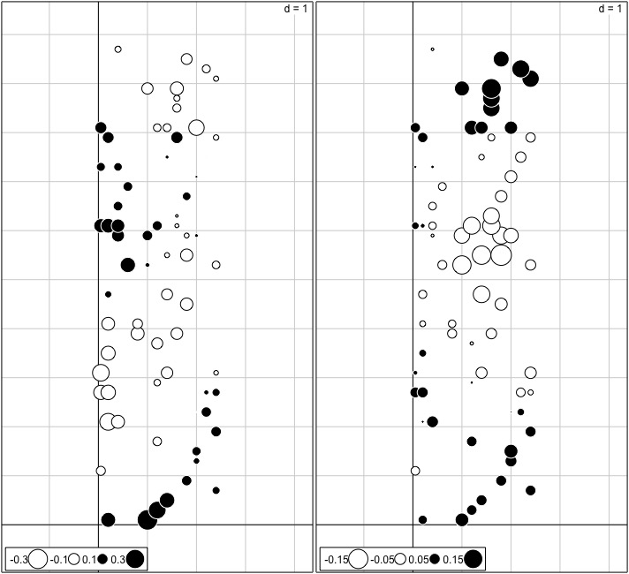
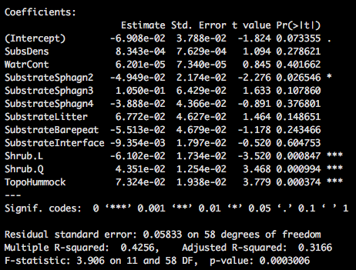
Axis 1
dbMEM: basics
Axis 2

Slide 25
Questions?
Notes:
condition of second order stationarity: uniform mean, covariance, and variance

Slide 26
References
McCune and Grace. 2002. Analysis of ecological communities. MjM Software Design.
Borcard, Gillet, and Legendre. 2011. Numerical ecology with R. Springer.
Numerical ecology

